Slide 1
Loan Default Rate Detection
DATE: 12/19/2023
Group Member:
Kendall
Lizzy
Abhijit
Tendai
Yujin
Henry
Group 12
Notes:
Group introductions
Our project approaches loan applications from the lenders perspective and analyzes what factors impact loan default rates so that the bank can strategize who is at highest risk at defaulting if they choose to lend to them.

Slide 2
Loan Default Rate Detection
DATE: 12/19/2023
Group Member:
Kendall
Lizzy
Abhijit
Tendai
Yujin
Henry
Group 12
Notes:
Group introductions
Our project approaches loan applications from the lenders perspective and analyzes what factors impact loan default rates so that the bank can strategize who is at highest risk at defaulting if they choose to lend to them.

Slide 3
Summary & Expectation
We wrangled the data into dimensional model using SQL to answer business questions.
In general, cash loans tend to have higher default rate compared to revolving loans
Male tend to have higher default rate among all monthly income groups compared to female
Expectation:
Income, occupation, and loan types will make a great contribution to default rate
Notes:
Main goal: To be able to apply our dataset and analysis to real-world business problems (our business problem surrounds loan applications and whether people had difficulty making payments)
General Processes: Used data wrangling and analysis techniques through SQL in order to answer our proposed business questions
Expectation: We expected that income, occupation, and loan types would all have a very significant impact on the default rate of loan applicants
Summary: We found that cash loans have a higher default rate compared to revolving loans.
A cash loan is when the borrower is given a lump sum of money that they must repay in fixed installments
A revolving loan is when a borrower sets up a credit limit and borrows money and repaying it on a recurring basis
More expectations: Males tend to have a higher default rate among all monthly income groups compared to females, even though on average in this dataset females have a lower monthly income.

Slide 4
Ask 1

Slide 5
Data Description
Dataset from September 2013 covering loan applications in India
Information covered: loan applicants demographic information, loan’s specifics , and loan applicants background check information regarding credit history
Data Source: The International Institute of Information Technology Bangalore
Dataset Size : 148.7 MBs. Contains 122 variables and 307,511 observations
Target Variable : whether or not the individual has payment difficulties
The currency used in this dataset is in Indian Rupee
Notes:
Where our data comes from: Our datasource comes from loan applications tracked by The International Institute of Information Technology Bangalore
The IIITB is a scientific research organization that stores large datasets pertaining to data science research.
What our data covers: Information about the loan applicants themselves (demographic information like gender), the loan specifics (loan amount and term), and information on the applicant's’ credit history
Dataset Description: 148.7 MBs, 122 variables, and 307,511 observations
Target: We are most concerned with whether an individual has payment difficulties (originally a binary variable)
Important note: The currency used is the Indian Rupee

Slide 6


Why is this data?
Assist the general public in understanding the variables that impact the default rate, particularly for lenders.
Suitable for data analysis and dimensional modeling with a dataset containing over 300k records.
122 variables in a well-structured dataset with a data dictionary to help in the selection and categorization of significant variables and the generation of analysis.
Notes:
Help the general public to understand which variables impact the default rate
Enough well-structured dataset over 300K with a data dictionary
So we can easily select and categorize the variables for our analysis.

Slide 7
Business Questions
In the provided loan data, what is the average loan default rate? What are the loan types along with which income levels have the higher default rate?
What are the differences between females and males regarding their average income and default rate? Also, within each gender group, which income level shows the highest frequency of defaults?
How can we identify and categorize the risk profiles of our loan applicants based on their income level, age group, and occupation? Specifically, which income group has the highest overall default rate, and within this group, which age bracket is most prone to defaulting? Furthermore, among the high-risk age bracket in the highest defaulting income group, what are the common occupation types, and how do their default rates compare?
Notes:
Brief descriptions:
We are going to answer the business questions based on our analysis.
Questions we are going to answers are:
Average loan default rate as well as the correlation between loan type and income levels to the default rate.
Default rate and income level by gender.
Risk profiles of loan applicants based on income, age, and occupation.

Slide 8


Concerns
Expected Modifications
Decrease the # of variables to 19
Group them into categorical variables to help have a clear understanding in the analysis.
Large number of variables
→ reduce accuracy
→ slow processing time
→ hard to interpret
Categorize columns like days_birth and cnt_chilldren
…
Notes:
Dropped columns which were ambiguous to improve explainability and interpretability ( # variables 112 → 19)
Did transformation of data type to have a clear understanding in the analysis.

Slide 9
Ask 2
Data Wrangling
Notes:
4 columns
AMT_REQ_CREDIT_BUREAU_HOUR
When analyzing the AMT_REQ_CREDIT_BUREAU_HOUR data, which represents the number of credit bureau inquiries made by a customer one hour before applying for Credit Card, , it's important to handle missing values effectively.
In this context, missing values are interpreted as zero. This assumption is based on the rationale that some customers might be new to credit loan applications and, as a result, have not yet initiated any inquiries.
Therefore, the absence of data in this field is likely indicative of no credit history or inquiries made during that period, justifying the substitution of missing values with zeros.
This approach ensures that our analysis accurately reflects the credit activity (or lack thereof) of all customers, particularly those who are new to the credit system."

Slide 10
Data Wrangling
Data filtering using SQL:
Replace the missing values with NULL or DATA NOT AVAILABLE
Group amt_income_level, cnt_children, amt_credit, amt_annuity, amt_req_credit_bureau_hour, and amt_req_credit_bureau_day into categories to gain a better understanding of client’s demographic
Calculate days_birth by dividing the dates by 365 to get the estimated age, and create categories of age groups
Amt_income_level_group:
lower group - <=100k
Lower middle group - 100k - 150k
Upper middle group - 150k - 200k
Upper group - >200k
Final dataset:
19 variables and 307,511 observations
Notes:
Group amt_income_level → Monthly income
4 columns with missing values out of the 19 chosen cols in DM
Replace with null and occupation - data not available
Assumption: transition phase, might be looking for a job
Grouped 7 columns - income example showing the grouping result, providing context for the 3 analysis questions
Derived col: age, the original dataset carries the number of days the customer has lived since birth

Slide 11
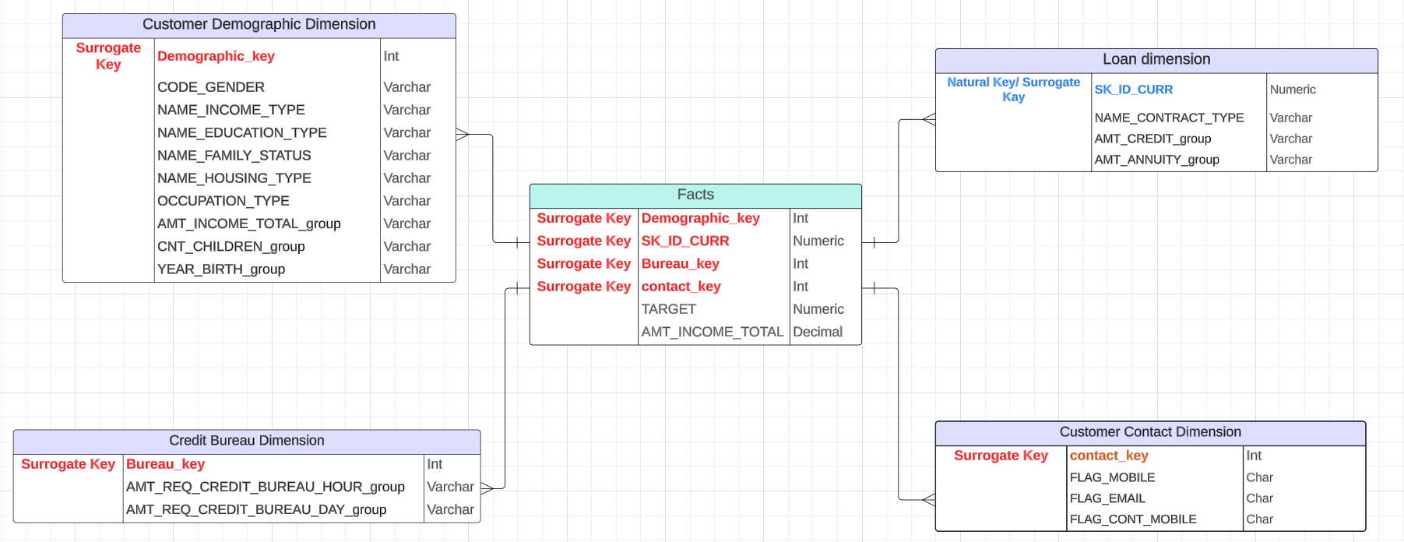
Dimension Model
Notes:
We have included a column called "TARGET" in the fact table to calculate the default rate and how it relates to various customer segments / dimensions because we are working with credit card data and any bank or financial institution's primary goal is to maintain a low level of non-performing assets.
We also wanted to find out the average income of the customers to whom the credit card was provided. We retained "AMT_INCOME_TOTAL" as a fact since we also wanted to see if a category with a high default rate had a low average income.
Customer Demographic Dimension Table contains columns that explain the customer demographics like gender,age,income_group,etc.
Loan Dimension Table contains columns that explain the loan attributes like contract type, credit amount etc.
Credit Bureau Dimension Table contains data that bank get from Credit Bureau liked credit enquiries made by the customer in the past.
Customer Contact Dimension Table contains columns which tell whether the customer had provided mobile and email id to the bank and whether his mobile number reachable.
-

Slide 12
Ask 3
Data Analysis

Slide 13

Use dimensional model to answer the three business questions!

Slide 14
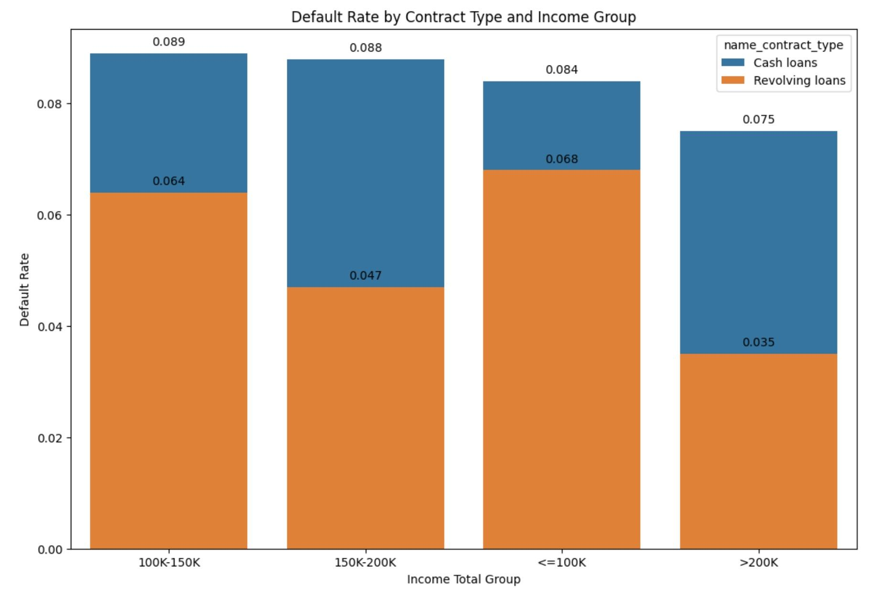
Q1: what is the average loan default rate? What are the loan types along with which income levels have the higher default rate?
Observations:
Avg_default_rate: 0.081
Lower middle income group (100k - 150k) have the highest default rate of 0.089 among cash loan
Lower income group (<=100k) have the highest default rate of 0.068 among revolving loan
Overall, cash loan in each monthly income group tend to have higher default rate compared to revolving loans
Notes:
Dimension table
Target variable from the fact table, used as the numerical type → default rate
Contract type from the loan dimension table
Cash loans
Revolving loans
Income group from the customer dimension table
Why we choose this question
This question aims to understand the overall risk profile associated with the bank's loan portfolio. By examining the average default rate, we can assess the general health and risk of the loan portfolio.
Investigating the correlation between loan types, income levels, and default rates helps in identifying specific segments that are more prone to default. This segmentation is crucial for risk assessment and management.
Business insights
Notably, the default rate is significantly higher for cash loans than for revolving loans across all income brackets, suggesting that cash loans carry a higher risk for lenders.
The lower middle-income group (100k - 150k) exhibits the highest default rate for cash loans, indicating a potential risk concentration in this segment.
Conversely, individuals with incomes above 200k demonstrate the lowest default rates, especially for revolving loans, suggesting greater financial stability or creditworthiness in this bracket.
These insights could drive financial institutions to tailor their risk assessment models, lending criteria, and product offerings to mitigate risk and optimize portfolio performance.
How it is beneficial to the bank?
This information can guide the development of targeted risk mitigation strategies, such as tailored credit scoring models or differentiated interest rates based on risk levels.
What are some potential steps we can do further to get more insights?
Longitudinal Study: Conduct a time-series analysis to understand if these default rates are consistent over time or if they fluctuate based on economic cycles.

Slide 15
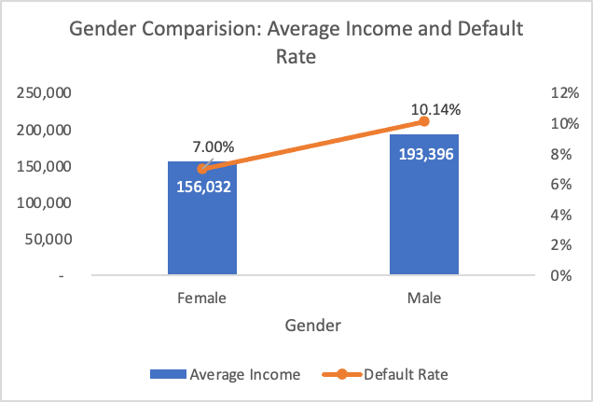
Q2: what are the differences between females and males regarding their average income and default rate?
Observations:
Female have lower average monthly income compared to male
Male have higher default rate compared to female
Overall, male have higher average monthly income and higher default rate
Notes:
Dimension table
Fact dimension
Target
Income
Customer demographics
Code gender
Why we choose this question？
To understand better the relationship between average income and default rate
Business insight？
We observe that in this dataset males have a high default rate regardless of relatively earning a high average income compared females and this goes in contrast with one of our expectations that low income earners are likely to have a high default rate.
How it is beneficial to the bank?
Banks can be cautious in lending loans they should focus more on other determinants to determine credit worthiness and not income level when it comes to gender
What are some potential steps we can do further to get more insights?
We can dive more into the type of jobs mainly done by the males and females and see whether these might explain why low average income has a low default rate amongst the woman

Slide 16
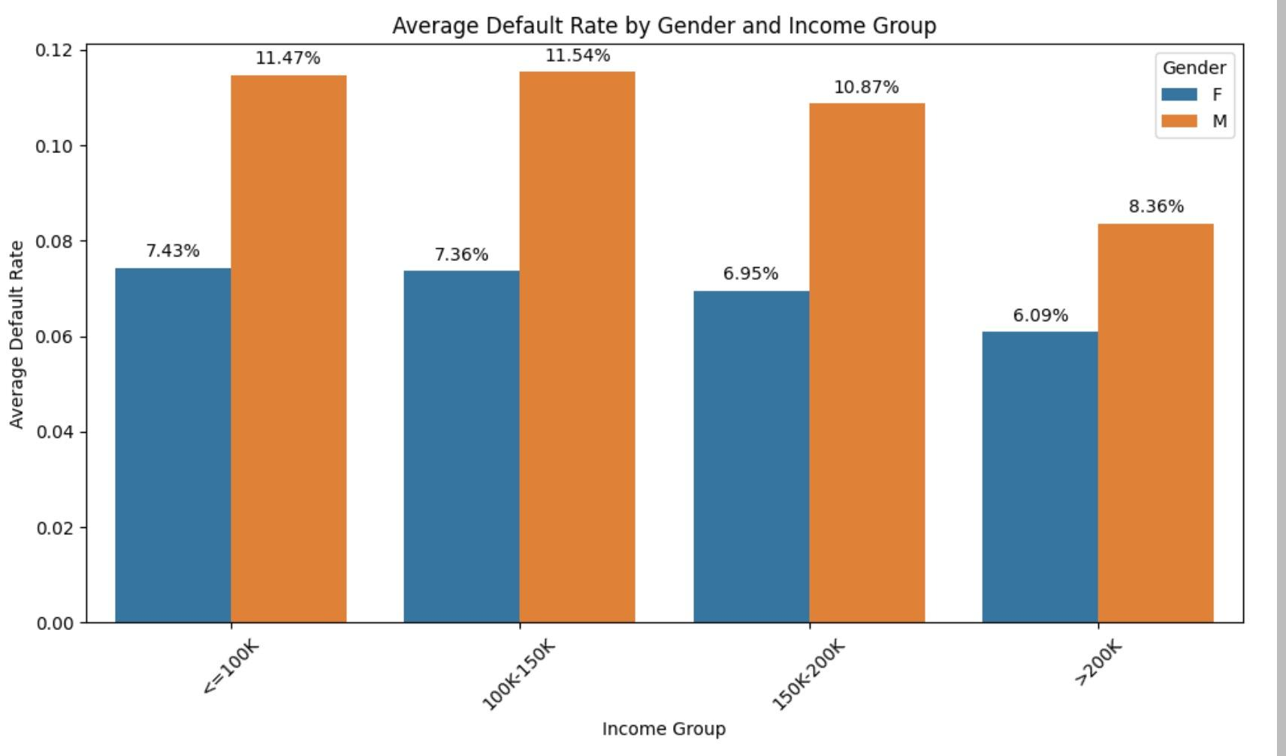
Cont Q2: Also, within each gender group, which income level shows the highest frequency of defaults?
Observations:
lower middle income groups have the highest default rate of 11.54% among male
Lower income groups have the highest default rate of 7.43% among female
Overall, male have higher default rate than female
Notes:
Dimension Table
Add the income level, to see the difference in gender among the income groups
Why we choose this question
To further understand the distribution of income between males and females at different income categories and the associated default rate
Business insight
We observe that in general males tend to have a high default rate at all levels of income compared to females
How it is beneficial to the bank?
Banks can be encouraged to lend more to the high income earning male individual as they pose lesser risk of the bank in losing money compared to the low income earners and middle income earners

Slide 17
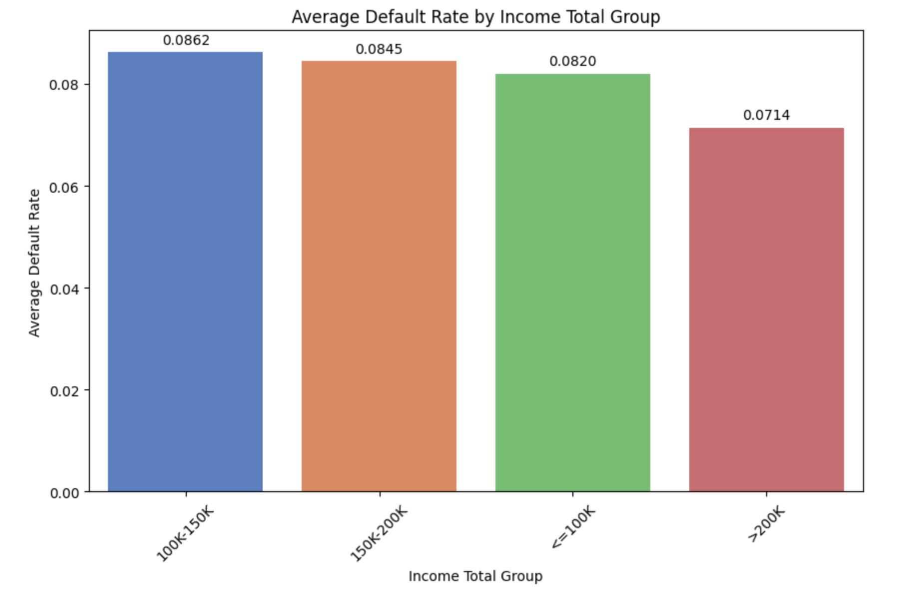
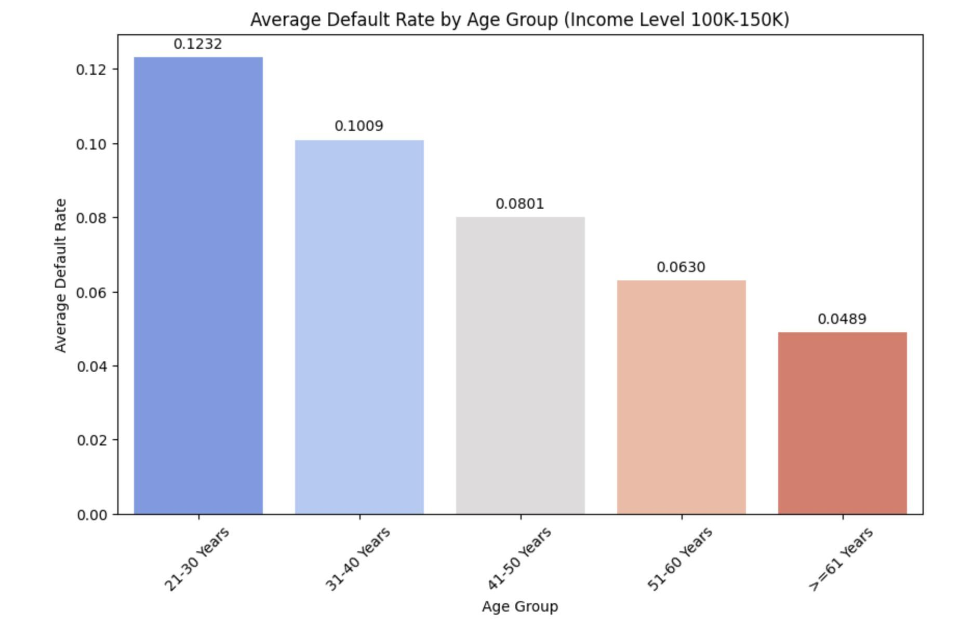
Q3: How can we identify and categorize the risk profiles of our loan applicants based on their income level, age group, and occupation?
Specifically, which income group has the highest overall default rate, and within this group, which age bracket is most prone to defaulting?
Lower middle income group have the highest default rate - 0.0862
21-30 years have the highest default rate - 0.1232
Notes:
Upper class is more financially stable and therefore less likely to default aligns with the data, as does the idea that the lower-income group has a lower default rate, potentially due to stricter lending standards and more conservative borrowing behavior.
for the middle class, It could also be influenced by factors such as
Debt Burden: Middle-income earners might have a higher debt-to-income ratio, as they might be more likely to take on debt for home mortgages, car loans, and education.
Financial Strain: They might not have as much disposable income or savings as the upper class, making them more vulnerable to financial disruptions like job loss or unexpected expenses.
Credit Access: Middle-income individuals might have better access to credit compared to the lower-income group but may not have the financial resilience of the upper class to manage that debt effectively.
There is a clear trend of decreasing defaulting rate with increasing age.This trend could indicate increased financial stability, better credit management, or more conservative borrowing behavior in older age groups.

Slide 18
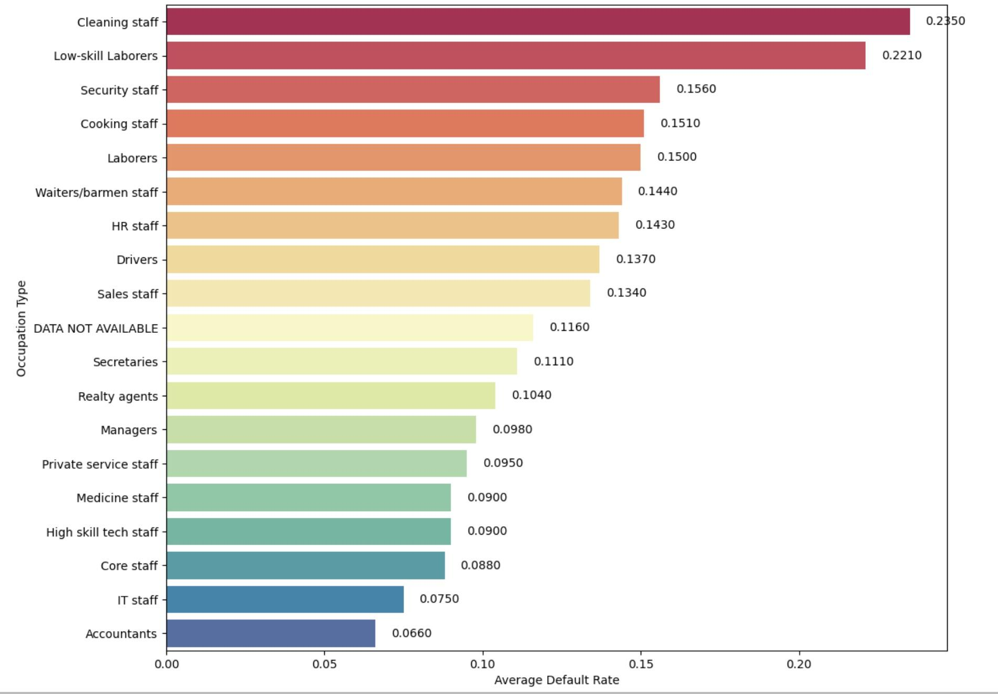
Cont Q3: Furthermore, among the high-risk age bracket in the highest defaulting income group, what are the common occupation types, and how do their default rates compare?
Observations:
Higher default rates occupations: Cleaning staff, Low-skill laborers, Security staff, Cooking staff
Lower default rates occupations: Accountants, IT staff, Core staff, high skill tech staff
Overall, occupations that require technical skills tend to have lower default rate

Slide 19
Question Time!

Slide 20
Summary & Expectation
We wrangled the data into dimensional model using SQL to answer business questions.
In general, cash loans tend to have higher default rate compared to revolving loans
Male tend to have higher default rate among all monthly income groups compared to female
Expectation:
Income, occupation, and loan types will make a great contribution to default rate
Notes:
Main goal: To be able to apply our dataset and analysis to real-world business problems (our business problem surrounds loan applications and whether people had difficulty making payments)
General Processes: Used data wrangling and analysis techniques through SQL in order to answer our proposed business questions
Expectation: We expected that income, occupation, and loan types would all have a very significant impact on the default rate of loan applicants
Summary: We found that cash loans have a higher default rate compared to revolving loans.
A cash loan is when the borrower is given a lump sum of money that they must repay in fixed installments
A revolving loan is when a borrower sets up a credit limit and borrows money and repaying it on a recurring basis
More expectations: Males tend to have a higher default rate among all monthly income groups compared to females, even though on average in this dataset females have a lower monthly income.

Slide 21
Ask 1

Slide 22
Data Description
Dataset from September 2013 covering loan applications in India
Information covered: loan applicants demographic information, loan’s specifics , and loan applicants background check information regarding credit history
Data Source: The International Institute of Information Technology Bangalore
Dataset Size : 148.7 MBs. Contains 122 variables and 307,511 observations
Target Variable : whether or not the individual has payment difficulties
The currency used in this dataset is in Indian Rupee
Notes:
Where our data comes from: Our datasource comes from loan applications tracked by The International Institute of Information Technology Bangalore
The IIITB is a scientific research organization that stores large datasets pertaining to data science research.
What our data covers: Information about the loan applicants themselves (demographic information like gender), the loan specifics (loan amount and term), and information on the applicant's’ credit history
Dataset Description: 148.7 MBs, 122 variables, and 307,511 observations
Target: We are most concerned with whether an individual has payment difficulties (originally a binary variable)
Important note: The currency used is the Indian Rupee

Slide 23
Why is this data?
Assist the general public in understanding the variables that impact the default rate, particularly for lenders.
Suitable for data analysis and dimensional modeling with a dataset containing over 300k records.
122 variables in a well-structured dataset with a data dictionary to help in the selection and categorization of significant variables and the generation of analysis.
Notes:
Help the general public to understand which variables impact the default rate
Enough well-structured dataset over 300K with a data dictionary
So we can easily select and categorize the variables for our analysis.

Slide 24
Business Questions
In the provided loan data, what is the average loan default rate? What are the loan types along with which income levels have the higher default rate?
What are the differences between females and males regarding their average income and default rate? Also, within each gender group, which income level shows the highest frequency of defaults?
How can we identify and categorize the risk profiles of our loan applicants based on their income level, age group, and occupation? Specifically, which income group has the highest overall default rate, and within this group, which age bracket is most prone to defaulting? Furthermore, among the high-risk age bracket in the highest defaulting income group, what are the common occupation types, and how do their default rates compare?
Notes:
Brief descriptions:
We are going to answer the business questions based on our analysis.
Questions we are going to answers are:
Average loan default rate as well as the correlation between loan type and income levels to the default rate.
Default rate and income level by gender.
Risk profiles of loan applicants based on income, age, and occupation.

Slide 25
Concerns
Expected Modifications
Decrease the # of variables to 19
Group them into categorical variables to help have a clear understanding in the analysis.
Large number of variables
→ reduce accuracy
→ slow processing time
→ hard to interpret
Categorize columns like days_birth and cnt_chilldren
…
Notes:
Dropped columns which were ambiguous to improve explainability and interpretability ( # variables 112 → 19)
Did transformation of data type to have a clear understanding in the analysis.

Slide 26
Ask 2
Data Wrangling
Notes:
4 columns
AMT_REQ_CREDIT_BUREAU_HOUR
When analyzing the AMT_REQ_CREDIT_BUREAU_HOUR data, which represents the number of credit bureau inquiries made by a customer one hour before applying for Credit Card, , it's important to handle missing values effectively.
In this context, missing values are interpreted as zero. This assumption is based on the rationale that some customers might be new to credit loan applications and, as a result, have not yet initiated any inquiries.
Therefore, the absence of data in this field is likely indicative of no credit history or inquiries made during that period, justifying the substitution of missing values with zeros.
This approach ensures that our analysis accurately reflects the credit activity (or lack thereof) of all customers, particularly those who are new to the credit system."

Slide 27
Data Wrangling
Data filtering using SQL:
Replace the missing values with NULL or DATA NOT AVAILABLE
Group amt_income_level, cnt_children, amt_credit, amt_annuity, amt_req_credit_bureau_hour, and amt_req_credit_bureau_day into categories to gain a better understanding of client’s demographic
Calculate days_birth by dividing the dates by 365 to get the estimated age, and create categories of age groups
Amt_income_level_group:
lower group - <=100k
Lower middle group - 100k - 150k
Upper middle group - 150k - 200k
Upper group - >200k
Final dataset:
19 variables and 307,511 observations
Notes:
Group amt_income_level → Monthly income
4 columns with missing values out of the 19 chosen cols in DM
Replace with null and occupation - data not available
Assumption: transition phase, might be looking for a job
Grouped 7 columns - income example showing the grouping result, providing context for the 3 analysis questions
Derived col: age, the original dataset carries the number of days the customer has lived since birth

Slide 28
Dimension Model
Notes:
We have included a column called "TARGET" in the fact table to calculate the default rate and how it relates to various customer segments / dimensions because we are working with credit card data and any bank or financial institution's primary goal is to maintain a low level of non-performing assets.
We also wanted to find out the average income of the customers to whom the credit card was provided. We retained "AMT_INCOME_TOTAL" as a fact since we also wanted to see if a category with a high default rate had a low average income.
Customer Demographic Dimension Table contains columns that explain the customer demographics like gender,age,income_group,etc.
Loan Dimension Table contains columns that explain the loan attributes like contract type, credit amount etc.
Credit Bureau Dimension Table contains data that bank get from Credit Bureau liked credit enquiries made by the customer in the past.
Customer Contact Dimension Table contains columns which tell whether the customer had provided mobile and email id to the bank and whether his mobile number reachable.
-

Slide 29
Ask 3
Data Analysis

Slide 30
Use dimensional model to answer the three business questions!

Slide 31
Q1: what is the average loan default rate? What are the loan types along with which income levels have the higher default rate?
Observations:
Avg_default_rate: 0.081
Lower middle income group (100k - 150k) have the highest default rate of 0.089 among cash loan
Lower income group (<=100k) have the highest default rate of 0.068 among revolving loan
Overall, cash loan in each monthly income group tend to have higher default rate compared to revolving loans
Notes:
Dimension table
Target variable from the fact table, used as the numerical type → default rate
Contract type from the loan dimension table
Cash loans
Revolving loans
Income group from the customer dimension table
Why we choose this question
This question aims to understand the overall risk profile associated with the bank's loan portfolio. By examining the average default rate, we can assess the general health and risk of the loan portfolio.
Investigating the correlation between loan types, income levels, and default rates helps in identifying specific segments that are more prone to default. This segmentation is crucial for risk assessment and management.
Business insights
Notably, the default rate is significantly higher for cash loans than for revolving loans across all income brackets, suggesting that cash loans carry a higher risk for lenders.
The lower middle-income group (100k - 150k) exhibits the highest default rate for cash loans, indicating a potential risk concentration in this segment.
Conversely, individuals with incomes above 200k demonstrate the lowest default rates, especially for revolving loans, suggesting greater financial stability or creditworthiness in this bracket.
These insights could drive financial institutions to tailor their risk assessment models, lending criteria, and product offerings to mitigate risk and optimize portfolio performance.
How it is beneficial to the bank?
This information can guide the development of targeted risk mitigation strategies, such as tailored credit scoring models or differentiated interest rates based on risk levels.
What are some potential steps we can do further to get more insights?
Longitudinal Study: Conduct a time-series analysis to understand if these default rates are consistent over time or if they fluctuate based on economic cycles.

Slide 32
Q2: what are the differences between females and males regarding their average income and default rate?
Observations:
Female have lower average monthly income compared to male
Male have higher default rate compared to female
Overall, male have higher average monthly income and higher default rate
Notes:
Dimension table
Fact dimension
Target
Income
Customer demographics
Code gender
Why we choose this question？
To understand better the relationship between average income and default rate
Business insight？
We observe that in this dataset males have a high default rate regardless of relatively earning a high average income compared females and this goes in contrast with one of our expectations that low income earners are likely to have a high default rate.
How it is beneficial to the bank?
Banks can be cautious in lending loans they should focus more on other determinants to determine credit worthiness and not income level when it comes to gender
What are some potential steps we can do further to get more insights?
We can dive more into the type of jobs mainly done by the males and females and see whether these might explain why low average income has a low default rate amongst the woman

Slide 33
Cont Q2: Also, within each gender group, which income level shows the highest frequency of defaults?
Observations:
lower middle income groups have the highest default rate of 11.54% among male
Lower income groups have the highest default rate of 7.43% among female
Overall, male have higher default rate than female
Notes:
Dimension Table
Add the income level, to see the difference in gender among the income groups
Why we choose this question
To further understand the distribution of income between males and females at different income categories and the associated default rate
Business insight
We observe that in general males tend to have a high default rate at all levels of income compared to females
How it is beneficial to the bank?
Banks can be encouraged to lend more to the high income earning male individual as they pose lesser risk of the bank in losing money compared to the low income earners and middle income earners

Slide 34
Q3: How can we identify and categorize the risk profiles of our loan applicants based on their income level, age group, and occupation?
Specifically, which income group has the highest overall default rate, and within this group, which age bracket is most prone to defaulting?
Lower middle income group have the highest default rate - 0.0862
21-30 years have the highest default rate - 0.1232
Notes:
Upper class is more financially stable and therefore less likely to default aligns with the data, as does the idea that the lower-income group has a lower default rate, potentially due to stricter lending standards and more conservative borrowing behavior.
for the middle class, It could also be influenced by factors such as
Debt Burden: Middle-income earners might have a higher debt-to-income ratio, as they might be more likely to take on debt for home mortgages, car loans, and education.
Financial Strain: They might not have as much disposable income or savings as the upper class, making them more vulnerable to financial disruptions like job loss or unexpected expenses.
Credit Access: Middle-income individuals might have better access to credit compared to the lower-income group but may not have the financial resilience of the upper class to manage that debt effectively.
There is a clear trend of decreasing defaulting rate with increasing age.This trend could indicate increased financial stability, better credit management, or more conservative borrowing behavior in older age groups.

Slide 35
Cont Q3: Furthermore, among the high-risk age bracket in the highest defaulting income group, what are the common occupation types, and how do their default rates compare?
Observations:
Higher default rates occupations: Cleaning staff, Low-skill laborers, Security staff, Cooking staff
Lower default rates occupations: Accountants, IT staff, Core staff, high skill tech staff
Overall, occupations that require technical skills tend to have lower default rate

Slide 36
Question Time!

